Slide 1

SHELL SCRIPTING
DARSHINI S

Slide 2
INTRODUCTION TO SHELL SCRIPTING
• Shell scripting is the program designed which are running by the unix/linux.
• The basic concept of a shell script is a list of commands, which are listed in the order of execution. good shell script will have comments, preceded by #sign.
• Shell can be any one of the following list.
1.The Boune Shell
2.The C Shell
3.The Korn Shell
4.The GNU Bourne-Again Shell
• Shell is a command-line interpreter and typical operations performed by shell scripts include file manipulation, program execution, and printing text.

Slide 3
TYPES OF SHELL
• What are the shell types which your operating system supports.
Syntax : cat / etc/shells
/bin/sh
/bin/dash
/bin/bash
/bin/rbash
• sh shell
sh stands for bourne shell.
Bourne shell is a original shell still used on unix system.
• C shell
The C shell is an interactive command interpreter and a command programming language that uses syntax similar to the C programming language.

Slide 4
TYPES OF SHELL
• Korn shell
The Korn shell is an interactive command interpreter. It conforms to the Portable Operating System Interface for Computer Environments (POSIX), an international standard for operating systems.
• GNU bourNe-again shell
Bash stands for Bourne - again shell, After sh reinvented, and it a standard GNU shell which is more flexible which is used in most of the linux operating system or unix based operating system including Mac OS and windows 10 also.
Syntax : which bash

Slide 5
SHELL VARIABLES
A variable is a character string to which we assign a value.
The value assigned could be a number, text, filename, device, or any other type of data.
The shell enables us to create, assign, and delete variables.
• Variable Names
The name of a variable can contain only letters (a to z or A to Z), numbers ( 0 to 9) or the underscore character ( _).
By convention, Unix shell variables will have their names in UPPERCASE.

Slide 6
SHELL VARIABLES
• Two types in variables
1.System variables 2.User defines variables
• System variables
Created and maintained by linux or unix operated system, this are some pre defined variables which are defined by operating system and this are the variables which are defined in capital cases when the varibales are capital then most likely it is system variables.
•User defined variables
It is created and maintained by the users and this type of variables are defined in lower cases but there is no strict rule to write only in lower cases but we can use capital letters.

Slide 7
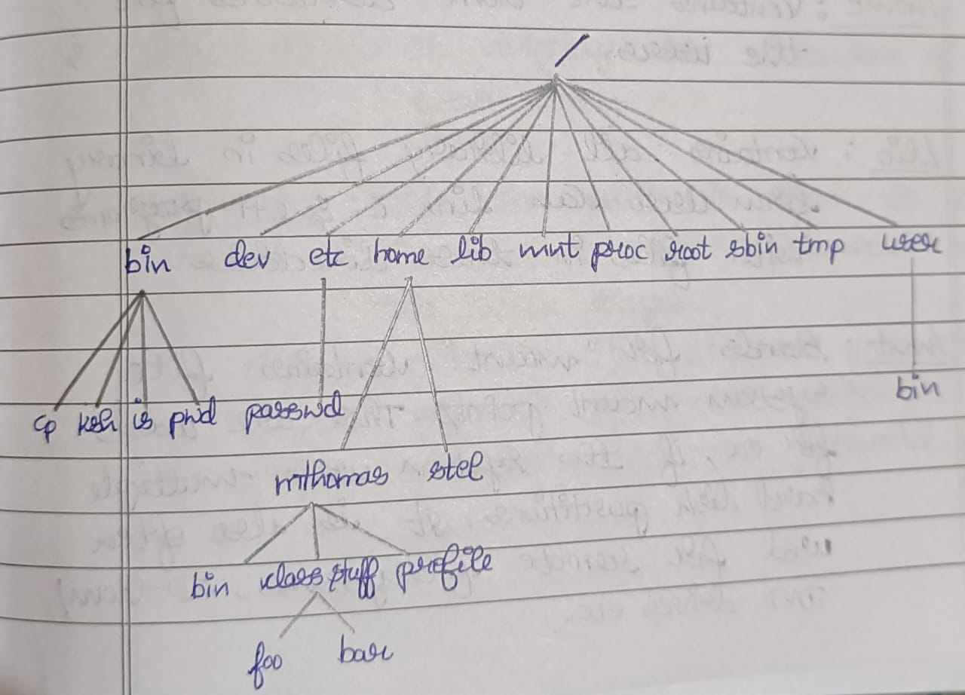
Unix file system
Data-> files->Directories-> file system

Slide 8
Directory Management
Home directory
Syntax : $ cd ~~ indicated home directory
listing directories
Syntax : $ls directory_name
Creating directories
Syntax : mkdir directory_name
Removing directories
Syntax : rmdir directory_name
Changing directories
Syntax : cd directory_name
Renaming directories
Syntax : mv old_directory_name new_directory_name

Slide 9
File Permission
Owner permissions − The owner's permissions determine what actions the owner of the file can perform on the file.
Group permissions − The group's permissions determine what actions a user, who is a member of the group that a file belongs to, can perform on the file.
Other (world) permissions − The permissions for others indicate what action all other users can perform on the file.

Slide 10
File Access Modes
r- read
w- write
x – execute
drwxrwxrwx 5 hamsagowda hamsagowda 4096 Jun 21 11:35 django
In that first character indicates the file type
d (directory)
- (file)
character from 2 to 4 specify the owners permissions
character from 5 to 7 specify the group permissions
character from 8 to 10 specify the others permissions

Slide 11
Directory Access Modes
Read
Access to a directory means that the user can read the contents. The user can look at the
filenames inside the directory.
Write
Access means that the user can add or delete files from the directory.
Execute
Executing a directory doesn't really make sense, so think of this as a traverse permission.

Slide 12
Changing Permissions
1. symbolic mode
2. absolute permissions
Number | Octal Permission Representation | Ref
0 | No permission | ---
1 | Execute permission | --x
2 | Write permission | -w-
3 | Execute and write permission: 1 (execute) + 2 (write) = 3 | -wx
4 | Read permission | r--
5 | Read and execute permission: 4 (read) + 1 (execute) = 5 | r-x
6 | Read and write permission: 4 (read) + 2 (write) = 6 | rw-
7 | All permissions: 4 (read) + 2 (write) + 1 (execute) = 7 | rwx

Slide 13
FILTERS
grep
Syntax : grep filename
Head
Syntax : head filename
Tai
lSyntax : tail filename
Cut
Syntax : cut filename
Paste
Syntax : paste filename
Sort
Syntax : sort filename

Slide 14
Processes Management
Starting a Process
Foreground Processes
Eg : ls cat and cal commands
Background processes
Eg : ls ch*.doc &

Slide 15
Processes Management
Listing Running Processes
Syntax : $ ps
PID TTY TIME CMD
22484 pts/3 00:00:00 bash
22551 pts/3 00:00:00 ps
Stopping Processes
$kill 6738

Slide 16
Processes Management
Parent and Child Processes
Syntax : $ ps -f
UID PID PPID C STIME TTY TIME CMD
hamsa+ 22484 12453 0 10:51 pts/3 00:00:00 bash
hamsa+ 23171 22484 0 11:22 pts/3 00:00:00 ps -f

Slide 17
Basic utilities
Printing files
Syntax : $pr filename
Sending Email
Syntax : $mail [-s subject] [-c cc-addr] [-b bcc-addr] to-addr

Slide 18
Network Communication Utilities
The telnet Utility
Syntax : $ telnet host-name
The finger Utility
Syntax : $ finger
The ping Utility
Syntax: $ ping host_name or ip_address
The ftp Utility
Syntax : $ ftp host_name

Slide 19
The vi Editor
Syntax : $vi filename
Modes of vi editor
1.Input mode
2.Execute mode
3.Command mode

Slide 20
THANK YOU

